Slide 1
The role of surface turbulent fluxes over the ocean in air-sea coupling Past experience and Future perspectives
Alessandro Storer | Supervisor: Hans Mikhail Segura Cajachagua
IMPRS ON EARTH SYSTEM MODELLING
PhD mandate: September 2025 – September 2028

Slide 2

Academic formation and current activity
2019
BSc. in Physics
University of Milan
2022
MSc. in Environmental Meteorology
University of Trento - University of Innsbruck
2024
Junior research assistant
University of Milan Bicocca – sup. Prof. Claudia Pasquero
One proceeding (accepted) and one full article (under rev.)
08.2025
09.2025
PhD candidate
Scale Interaction Modelling group – sup. Dr. Hans Segura

Slide 4

Academic formation and current activity
2019-2022 BSc. in Physics
University of Milan
Review of the comparison between state-of- the-art reanalysis ERA5 and observational data over normal values and long-term trends
2022-2024 MSc. in Environmental Meteorology
University of Trento - University of Innsbruck
Studying the mesoscale coupling between atmosphere and ocean in a high-resolution simulation: how are the marine boundary layer and heat fluxes impacted by the SST anomalies?
01.2025 – 08.2025 Junior research assistant
University of Milan Bicocca
One proceeding (accepted) and one full article (under rev.)
10.2025 – current PhD candidate
IMPRS Hamburg - Scale Interaction Modelling group
The energetics of the maritime boundary layer in the development of tropical convection

Slide 5
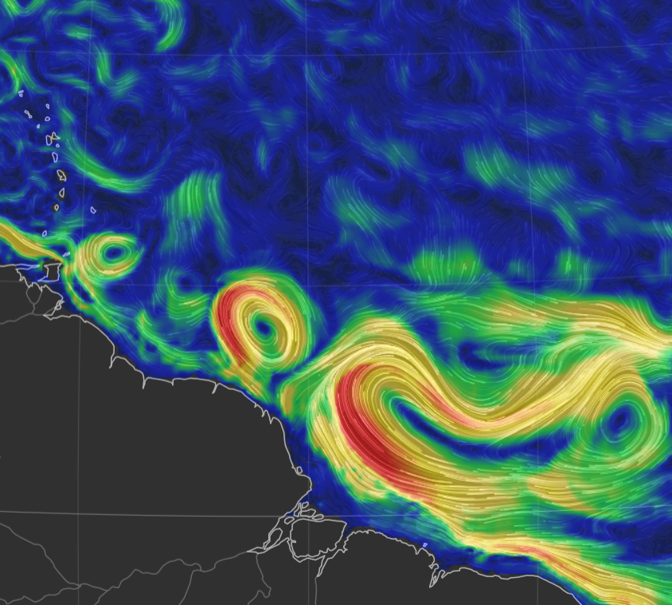

The sub- / mesoscale coupling
Scales < 1000 km are important
in the global energy budget!
(Renault et al. 2023, Seo et al. 2023,
Bishop et al. 2020)
20N
10N
Thermal feedback TFB
Modulates local temperature, stability and circulation through modified thermodynamic fluxes
(Acquistapace et al. 2022)
EQ
60W
50W
40W
How does SST variability act to modulate surface fluxes and hence the air column response?
Sea Sfc. currents on 25° Jan 2020
earth.null.school
How does the importance of SST change with scales?
Notes:
Check minobe’s and chelton’s, fabien’s articles for summarizing image

Slide 6
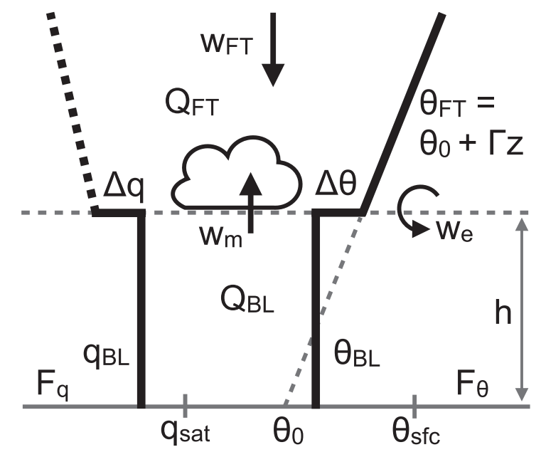
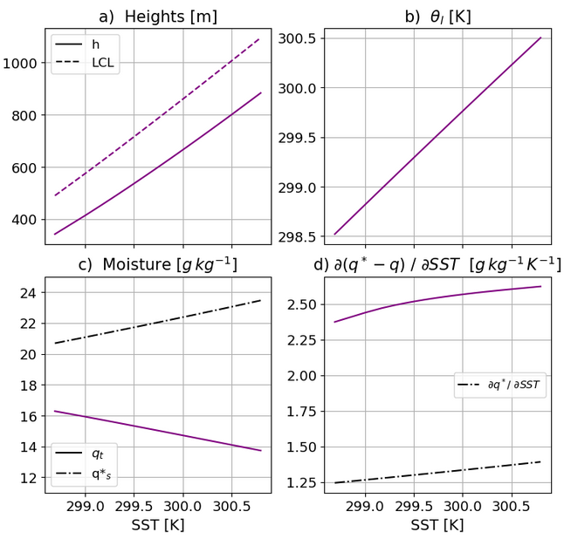
A minimal physics approach
Conceptual Bulk model
starring:
Stevens et al. 2002
Neggers et al. 2006
Naumann et al. 2019

Slide 7
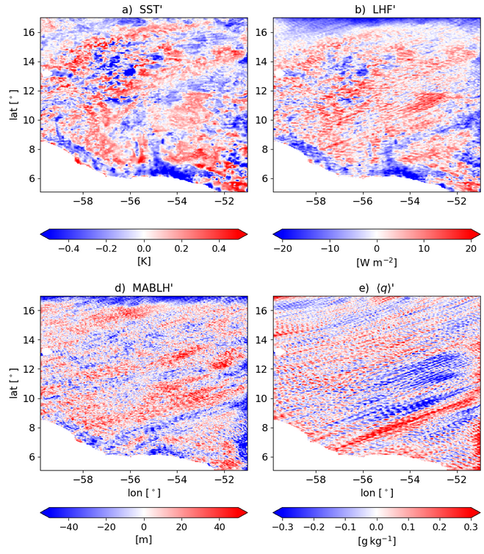
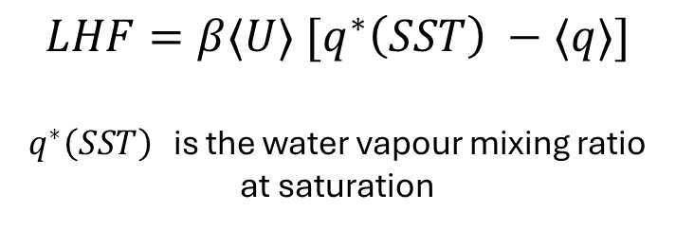
A realistic (complex) set-up
High-resolution WRF simulation:
Gridspace 3km
Daily SST forcing
Daily averages in February 2020
EUREC4A region (Stevens et al. 2021)
$$LHF=β⟨U⟩ [q^{∗}\left(SST\right) −⟨q⟩]$$
$q^{∗}\left(SST\right)$ is the water vapour mixing ratio at saturation

Slide 8
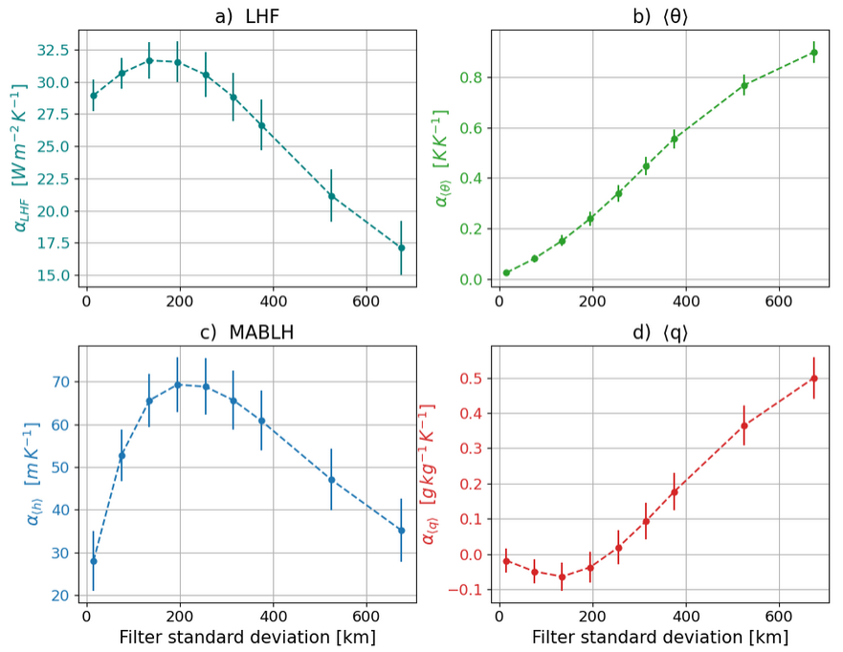

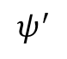
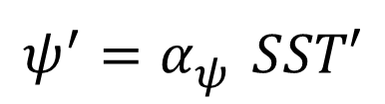
Scale-dependent coupling
$$ψ^{′}=α_{ψ}^{} SST′$$
$$ψ^{′}$$
SST’

Slide 9
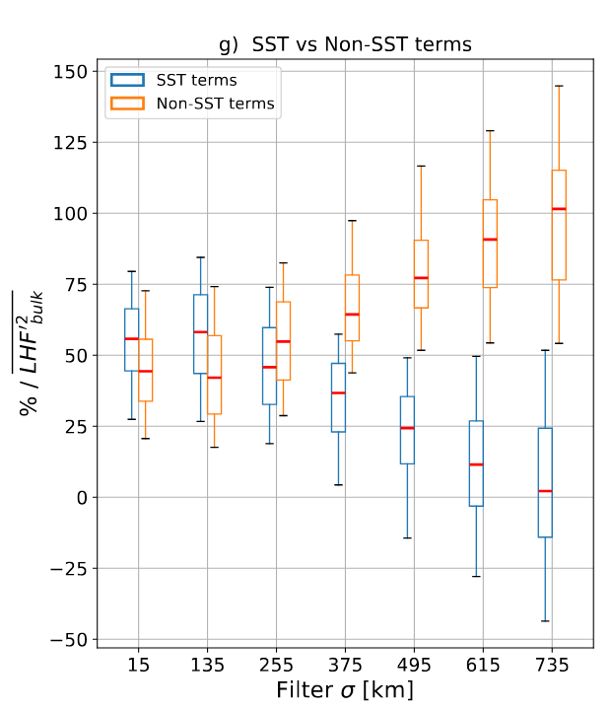
Spatial variability of lhf exchange
Now, with this acquired knowledge ….

Slide 10
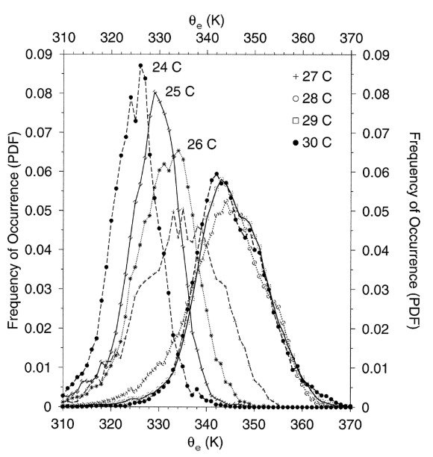
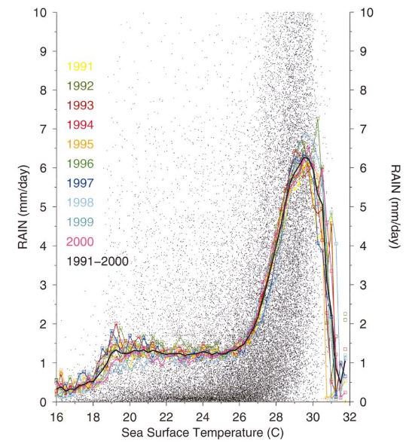
Boundary layer quasi-equilibrium

Slide 11


Boundary layer quasi-equilibrium
MABL
$\dot{MSE}≈SHF+LHF$
SHF
LHF
The warm sea of the Warm Pool
MSE
Notes:
Check how WRF is computing surface fluxes in the coupled simulation

Slide 12
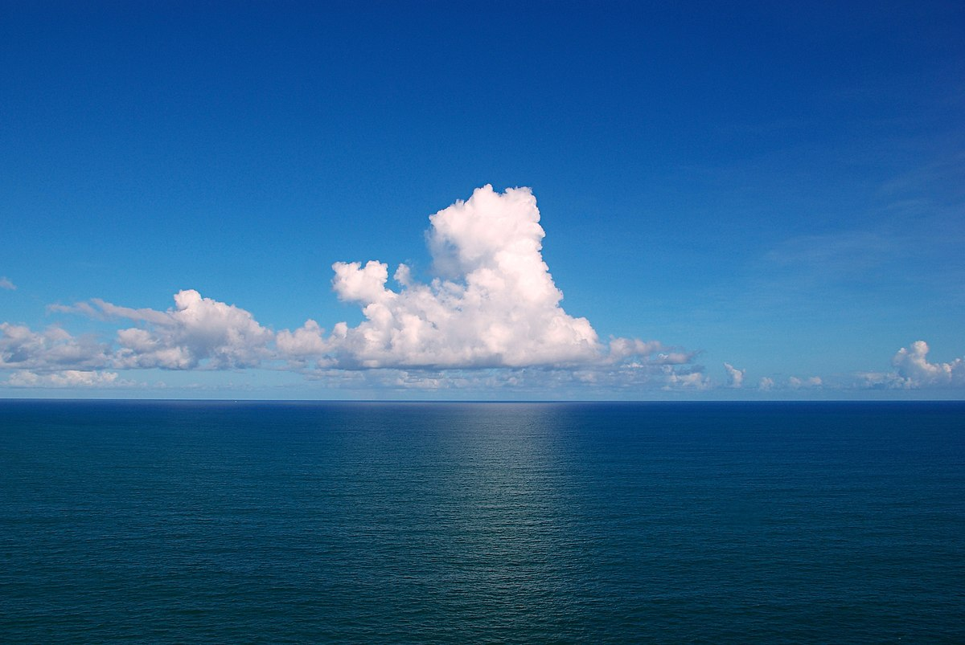
Boundary Layer
T , q air
wind
SST, q source
Turbulent fluxes
LHF, SHF
currents
Notes:
the coupling between marine shallow
trade-wind clouds and circulation is known to play a cen-
tral role in the uncertainty of the tropical cloud feedback and climate sensitivity estimated by models

Slide 13
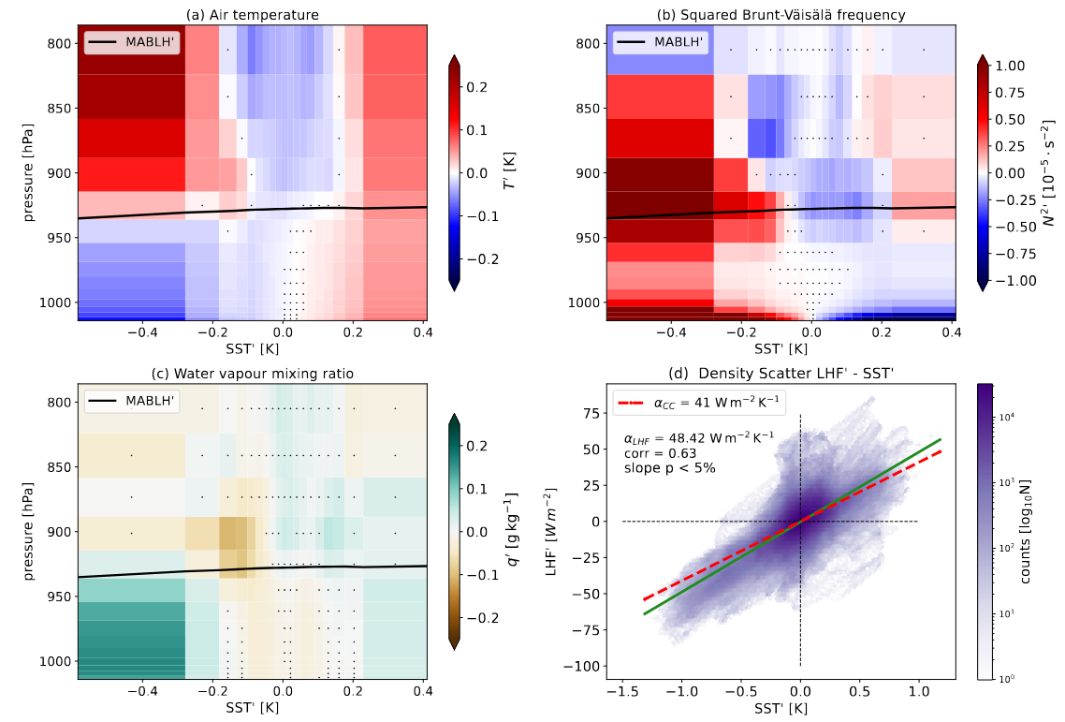
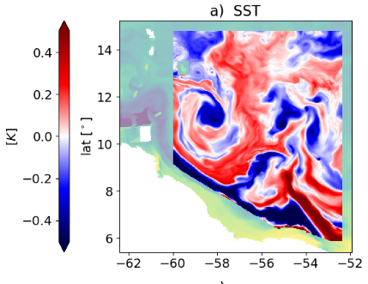
Vertical MABL response in a coupled simulation
a) Fully-coupled simulation
Fixed scale of interest < ~150km
→ correlate SST’ with atmosphere

Slide 14
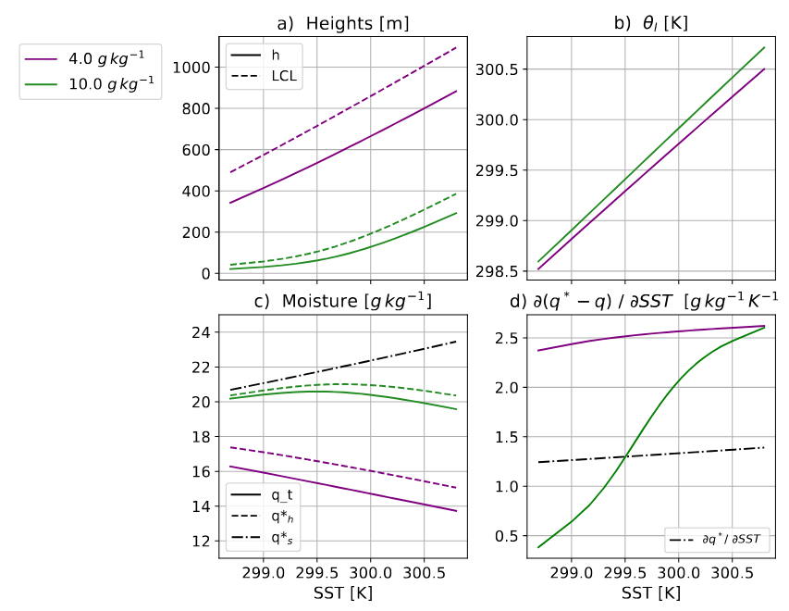
Two conceptual scenarios

Slide 15
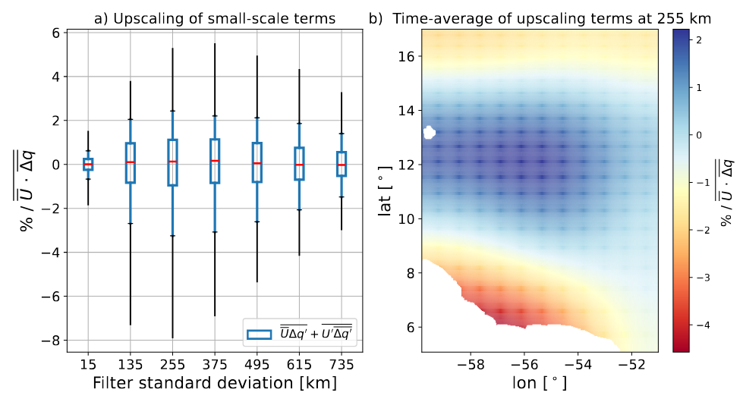
Upscaling effect in LHF modulation

Slide 16
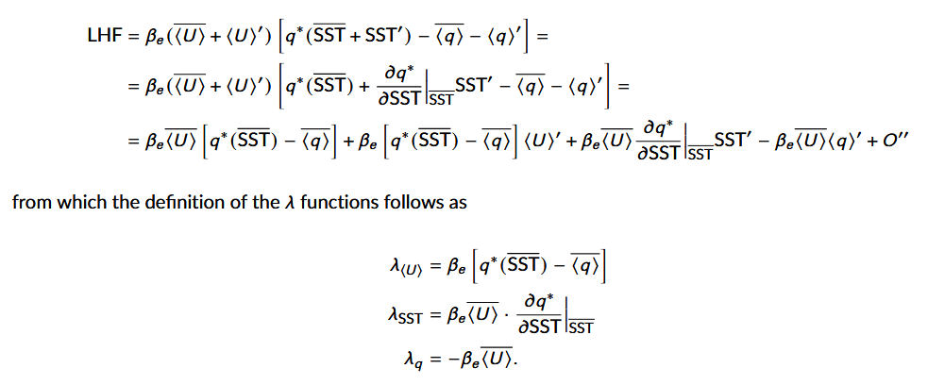
Backup

Slide 17

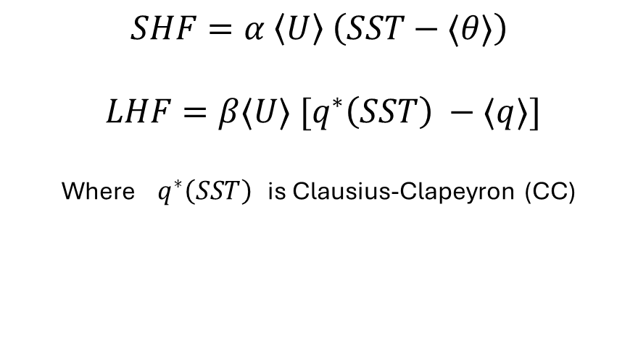
Sensitivity of surface fluxes to SST
MABL
$$SHF=α \left\langle U\right\rangle \left(SST−⟨θ⟩\right)$$
$$LHF=β⟨U⟩ [q^{∗}\left(SST\right) −⟨q⟩]$$
Where $q^{∗}\left(SST\right)$ is Clausius-Clapeyron (CC)
SHF’ ?
LHF’ ?
SHF’ ?
LHF’ ?
$$sensitivities == \frac{∂HF′}{∂SST′}$$
SST’ < 0
SST’ > 0
Notes:
Check how WRF is computing surface fluxes in the coupled simulation

Slide 18



A minimal physics approach
What is the range of validity of this 1D bulk model ?
How does the thermodynamic adjustment change with scales?

Slide 19
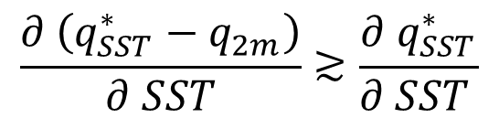
Conclusions
MABL – SST coupling is scale-dependent
Primary mechanism for
thermodynamic adjustment
over daily means
MABLH’
Feedback on surface LHF
$$\frac{∂ \left(q_{SST}^{∗}−q_{2m}\right)}{∂ SST}≳\frac{∂{ q}_{SST}^{∗}}{∂ SST }$$
Small-scale SST variability
dominates LHF variance
and excites non-linear upscaling effects
SST’ < 0
SST’ > 0

